Slide 1
F2F Meeting
16-08-2024

Slide 2
Last meeting …
Looked in depth into the gene expressions of 13+ distinct pathways
Also detailed the findings of the KEGG enrichment results
Decided that the progenitors were no longer interesting for this specific aspect of the study.
Noted that proteasome, endoplasmic reticulum, heatshock proteins required further evaluation
Next step for this aspect is to determine if published information is consistent with the findings.

Slide 3
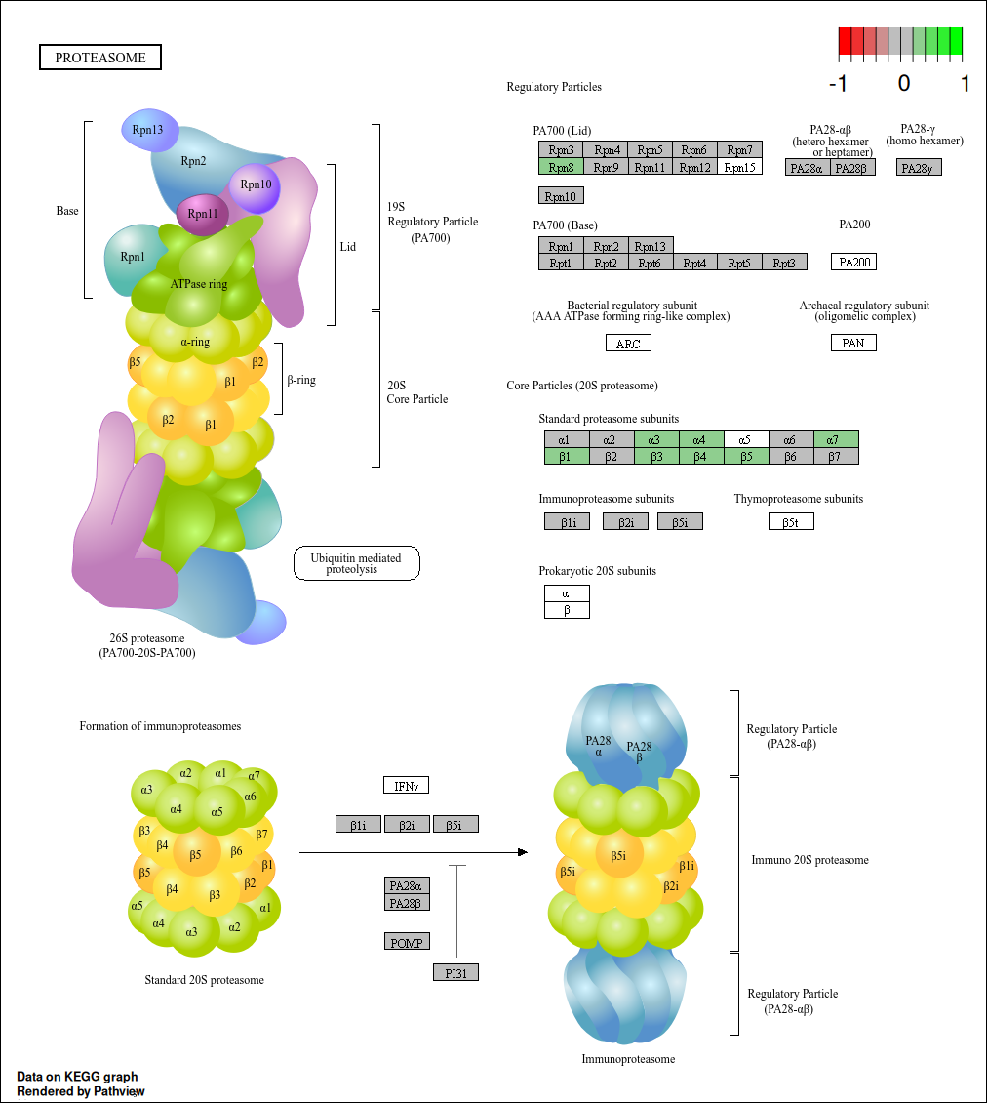
Enterocyte
Proteasome
20S subunit is responsible for the ATP dependent catalytic activity and is made up of two external alpha rings and two internal beta rings. Both alpha rings and beta rings each contain seven distinct subunits (alpha 1-7 and beta 1-7).

Slide 4
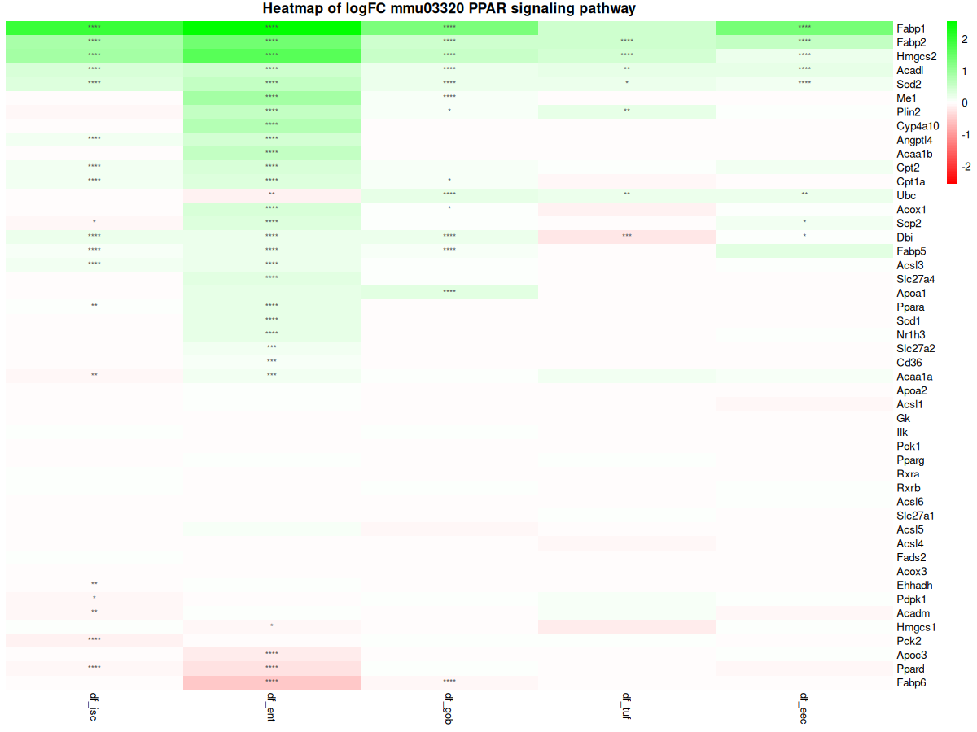

Slide 5
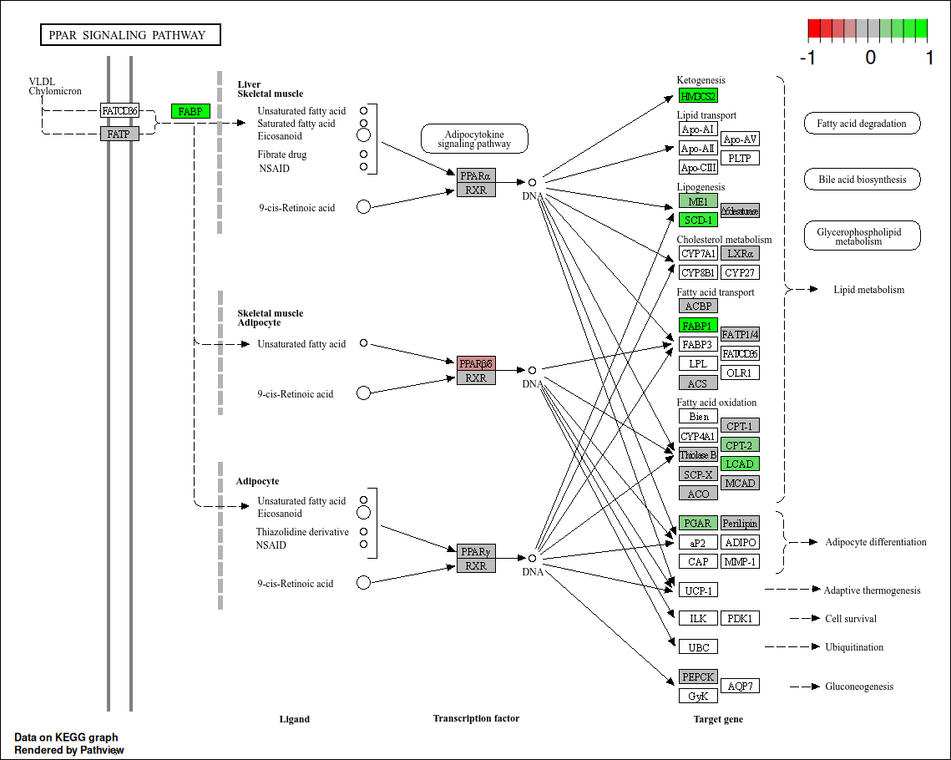
Enterocyte
PPAR

Slide 6
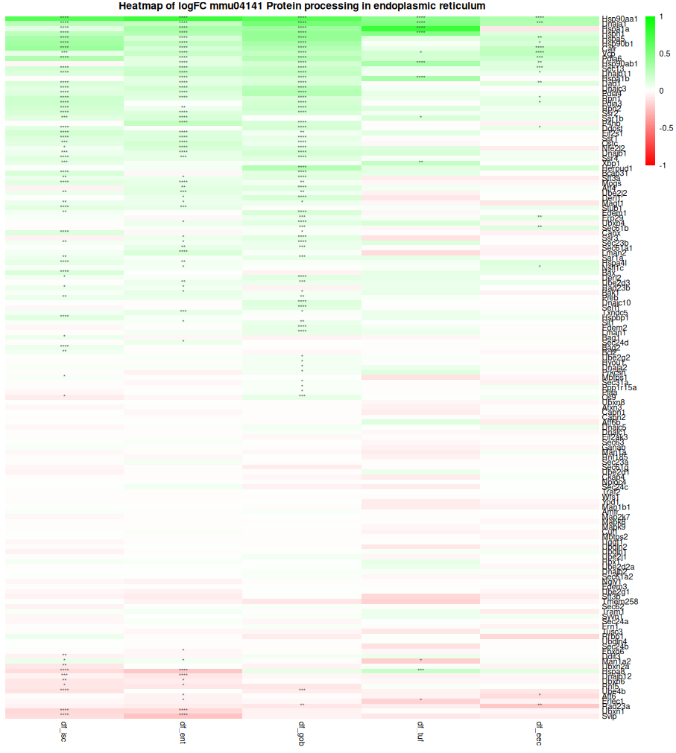
Endoplasmic
Reticulum

Slide 7
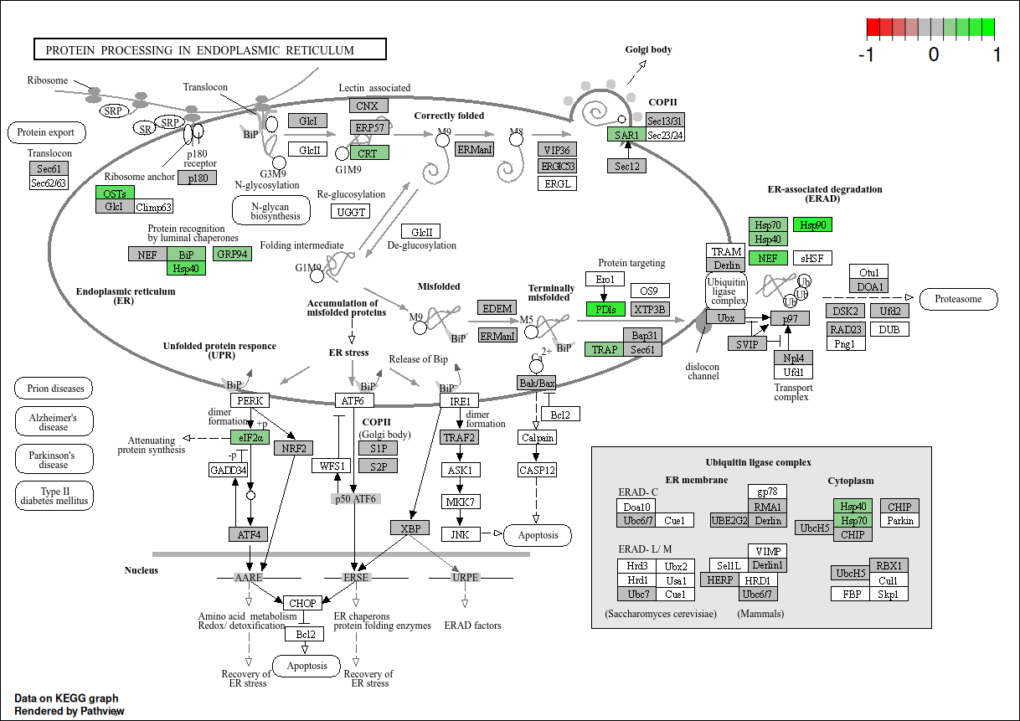

Slide 8
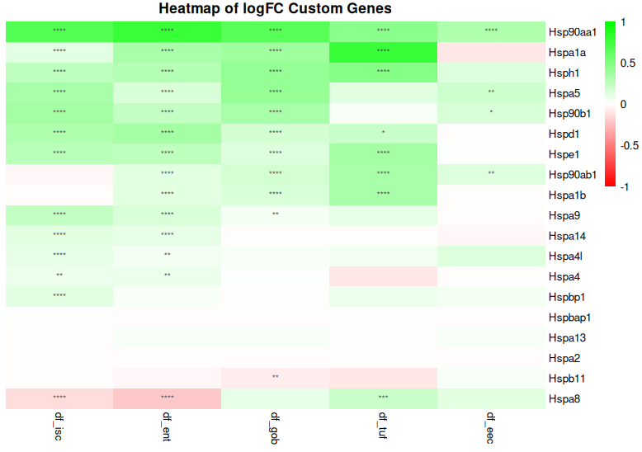

Slide 9
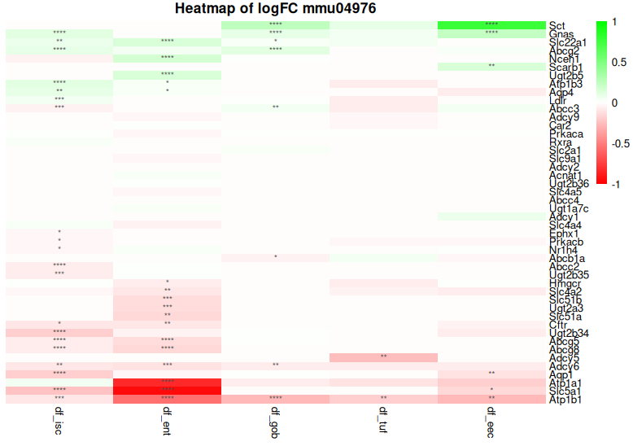
Bile Secretion

Slide 10
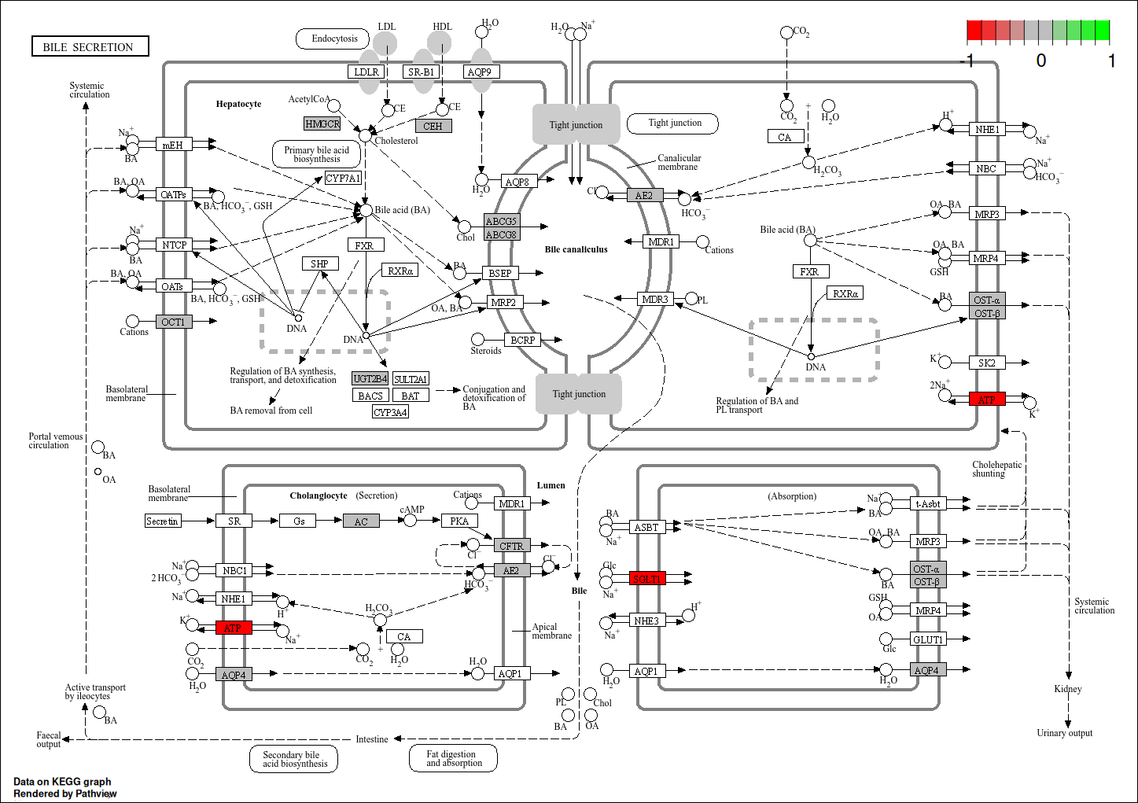

Slide 11
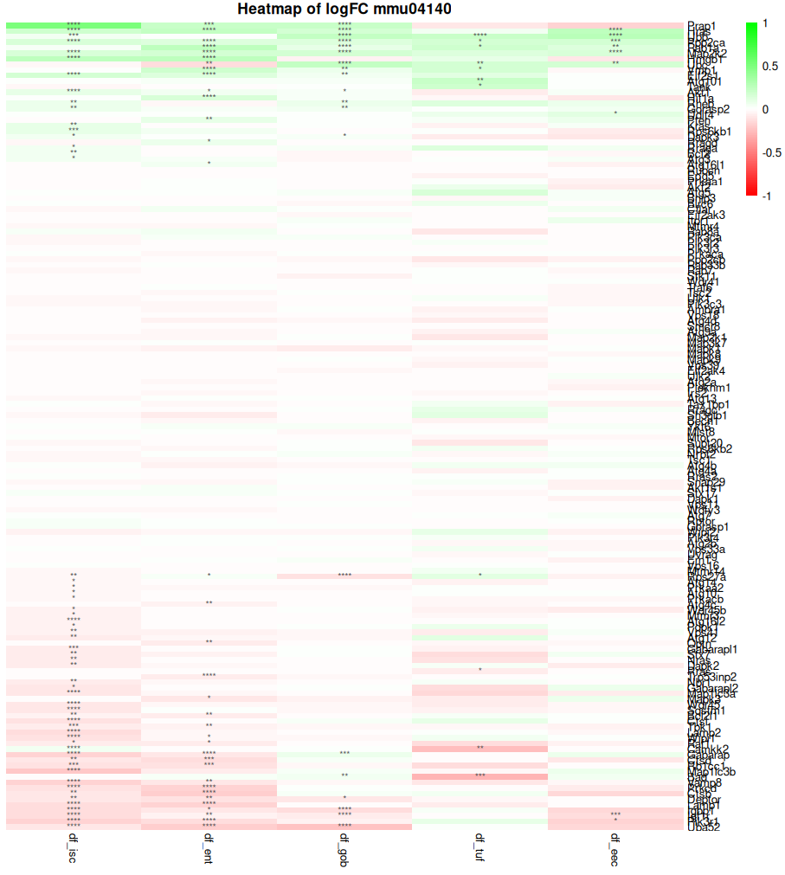
Autophagy

Slide 12
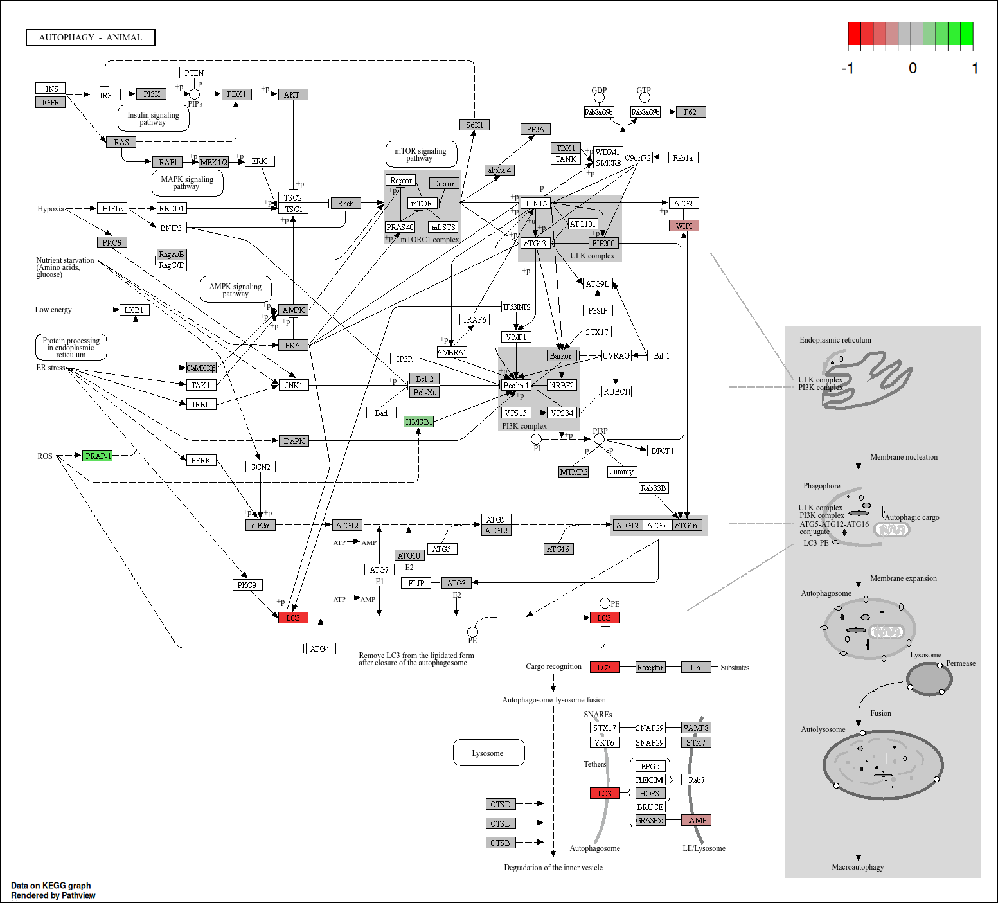
Autophagy
ISC

Slide 13
This week (and next week)
This / next week's focus is to produce a first draft of the literature review.
Rough plan is to produce 3 high quality pages of writing per day.
Structure of the review is in the next slides …

Slide 14
Sections of the literature review
Type 2 diabetes Mellitus
Prediabetes / metabolic syndrome
Current pharmacological interventions
Brown seaweed extract as a compound for alleviating prediabetes
The Intestinal Epithelium / diabetic gut
Multi-omics / scRNA seq for unveiling novel metabolic information
Using mouse models for studies on T2DM
Pathways of interest for the study (Insulin signalling pathway, tight junction, carbohydrate/fatty acid metabolism, cell fate, proteasome, spliceosome)

